Slide 1
Before Dark
Designed by React Gaming

Slide 2
Team Members:
Mike Gee – group leader, manages the project’s progress and quality while supporting the programmers.
Angel Martinez - lead artist and designer of character art as well as SFX, music, and voice.
Bram Metz - lead artist and designer of game environment and art style direction.
Jordan Mese - programmer specializing in design of mechanics.
Courtland Crouchet - programmer specializing in website design.
Leopold Frilot - programmer focusing on documentation.

Slide 3
Summary
“Before Dark” is a 3D third-person action-based puzzle platformer game which follows an imaginative young kid through an afternoon at the local neighborhood park.
The experience of “Before Dark” revolves around the horizon that exists between the main characters active imagination and the real world. Go on quest to find remarkable weapons, defeat foes, recover the milk, and return safely home before the sun sets and the neighborhood streetlights come on.

Slide 4
Characters
Pablo - the main character of the game and the character you will be playing as. He is the righteous protector of mankind, sworn to protect his land from evil. Well, at least that’s what he would tell you. Pablo is a dutiful, resourceful, 9yo kid playing at the local park. With a stick in his hand and a snack in his pocket, he vows to complete his mother’s quest.
Older brother - is the driving force of the game. He presents Pablo with his main “quest” at the beginning of each playthrough and reminds Pablo that he needs to return before the streetlights turn on at regular intervals. The older brother also gives the level specific quest to find something located in one of the areas of interest in the park.
Homeless man - blocks passage to the next level. The homeless man likes to play along with Pablo’s imaginary world and tells him what he needs to continue to the boss of the level. He is represented physically sitting on a park bench and will move the bench once Pablo has the necessary requirements.

Slide 5
Levels
The game takes place in three different areas:
A forest right outside a fenced in park
The local park itself, which is quite vast, and includes hills, trees, boulders, playground equipment, water fountains, winding sidewalks, and a few park benches which the homeless man likes to populate.
Pablo’s home neighborhood , where he must return to complete his given quest.
As Pablo traverses through the levels, he will come closer and closer to the main road which leads him back home. Meanwhile, time will pass, and light will dim, turning the pleasant afternoon shadows into something almost sinister.

Slide 6
Narrative
The story behind “Before Dark” is simple. Pablo, a 9yo boy, is playing in the park while his older brother watches over him. It’s getting late and the older brother reminds Pablo that they need to return home before it gets dark with all the groceries they had bought earlier in the day.
Pablo turns this message into his own heroic quest. He grabs a stick and ventures forth through the forest, into the park, and back to his neighborhood suburb where he has to find the groceries he lost, and return home before the sun goes down and the streetlights turn on.

Slide 7
Mechanics
run, roll, and jump in a 3D environment.
attack enemies
pick up various items which will either aid progression towards quest or buff Pablo
be stopped by “hazardous” terrain when lacking proper gear.
overcome certain terrains when certain items are equipped.
watch a timer which shows the time of day in game.
talk to the homeless man.

Slide 8
Core Game Loop
The player will spawn at the start of each level and be told what to find by the older brother.
The player will then have to explore the area looking for the object, fighting “enemies” off along the way and finding “items” to help him on his journey.
The player will then talk to the homeless man and be allowed into the boss room.
After defeating the boss, the next level will start.
If the player loses all health, they will respawn at the beginning of the level, but time will continue. This will repeat until he has made it to the sidewalk or time has run out
The player will be able to find clocks which add time to extend the quest counter.

Slide 9
Game play
At the beginning, enemies will be weak and sporadic. There will be a sense of calm as you explore the forest area. The sounds of birds chirping, and other soothing ambient sounds will play periodically.
The player will find items throughout the level which will buff him permanently and give him access to new areas previously impossible to reach. However, as time passes, the sun will sink lower and lower. The light color and amount will change accordingly.
Enemies/bosses’ stats will grow, and normal enemies will become more numerous. Naturally, with the sun lowering, shadows will grow longer, volume of ambient sounds of calm will be lowered, and volume of ambient sounds of stress(insects, frogs, etc.) will be heightened

Slide 10
Enemies
There will be several enemies and three bosses which Pablo will encounter at the end of each level:
Normal enemies:
Goblins – (level 1) first enemy the player will encounter in “Before Dark”
Zombies – (level 1 and 2) slow and not very smart. However hit harder as the sun goes down
Ghost – (level 2 and 3) more of a supportive enemy, and have a scream which stuns the main character
Robots – (level 2 ) quick movement and have ranged attacks
Spiders – (level 3) very quick and have a large detection radius. Short cooldown on attacks
Wolves – (level 3) attacks include a charge, bite, and seldomly a howl which debuffs Pablo

Slide 11
Enemies – cont.
Bosses:
Paco the Clown, first boss of the game. Pablo hates clowns. He thinks they are stupid.
Dr. Dentist - second boss of the game. A horrifying entity that represents shots from the doctor and visits to the dentist. Expect a lot of drills and needles.
Shadow Boss – final boss of the game. A shadow entity with a mysterious twist. The shadow boss scales in strength as the sun goes down. Beat the game to find out who the shadow boss really is.

Slide 12
Art
We decided to go with a simple, cell shaded style similar to Risk of Rain 2 and Breath of the Wild. One that is pleasing to look at while not being too complicated in nature.
Although the design features use of lower polygon models, we are not looking towards the direction of the low-poly aesthetic where hard edges are clearly defined and noticeable.
The simplistic style matches the imaginative nature of an innocent boy fighting imaginary monsters.

Slide 13
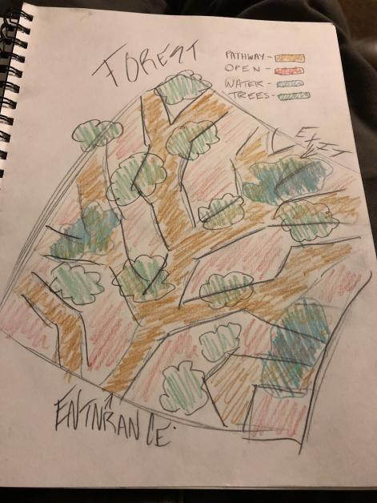
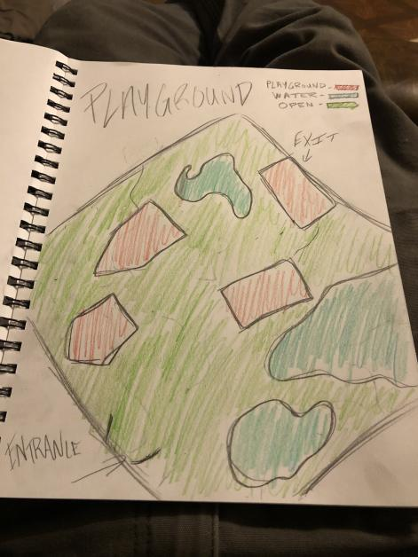
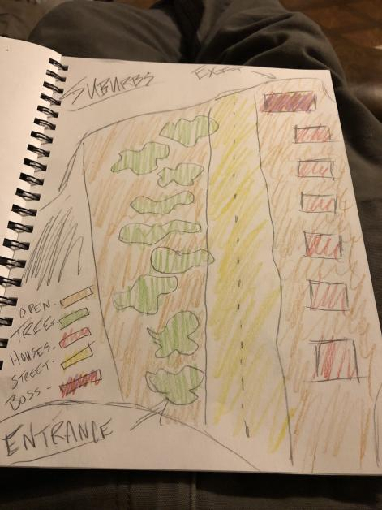
Level Design – concept art
Forest
Playground
Suburb

Slide 14
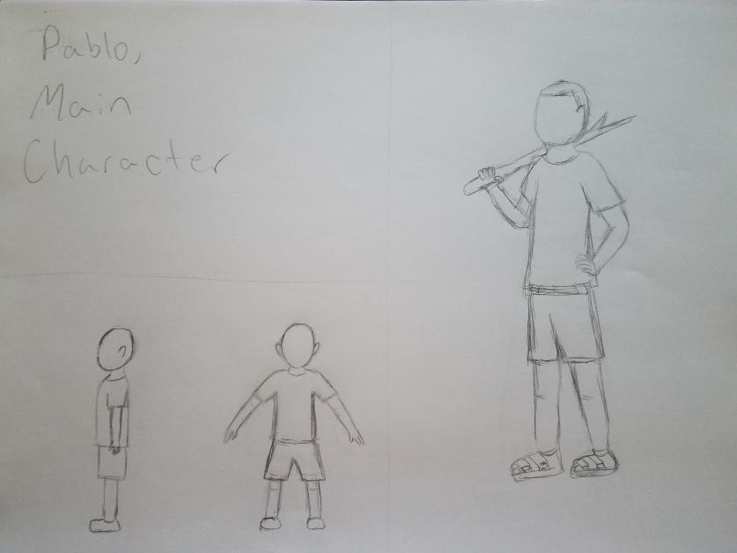
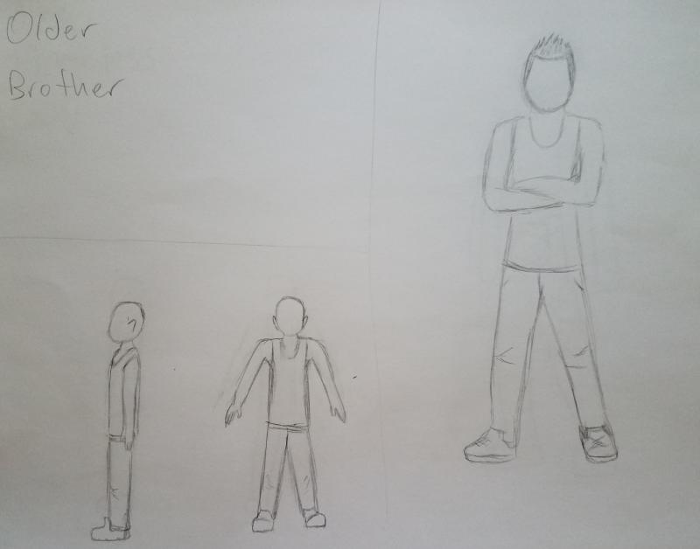
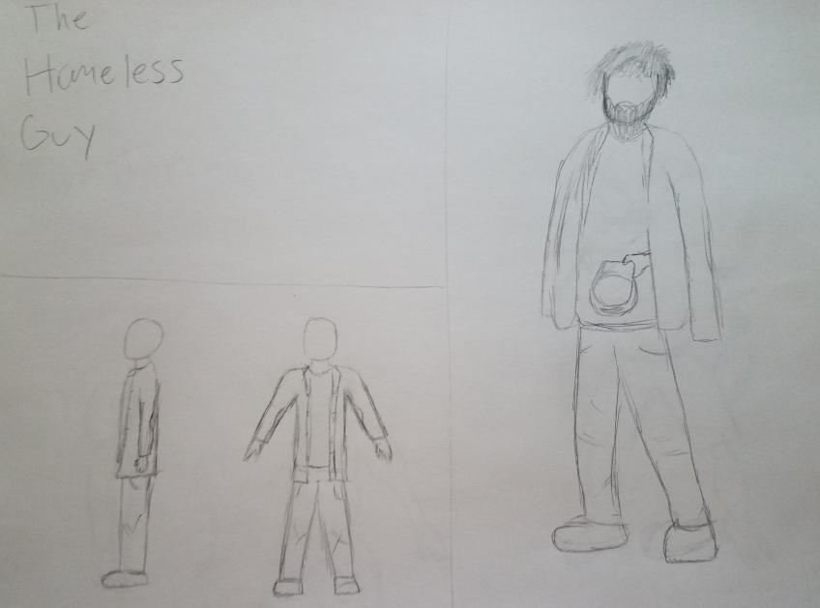
Character Design – Concept Art
Pablo
Older Brother
Homeless Guy

Slide 15
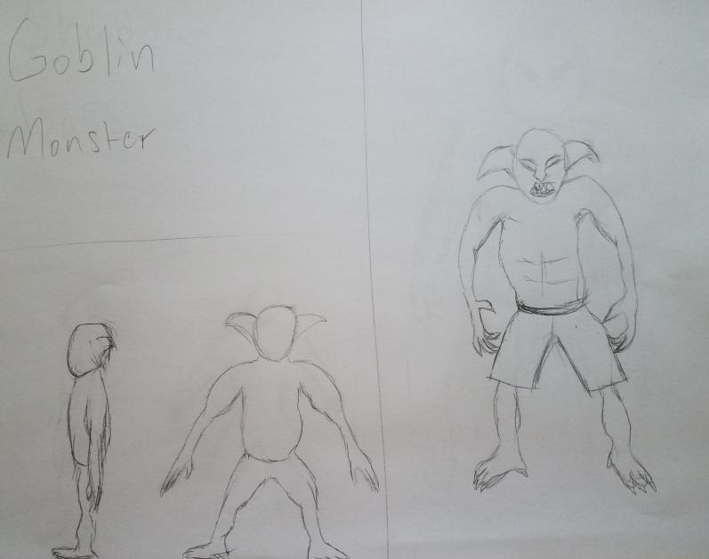
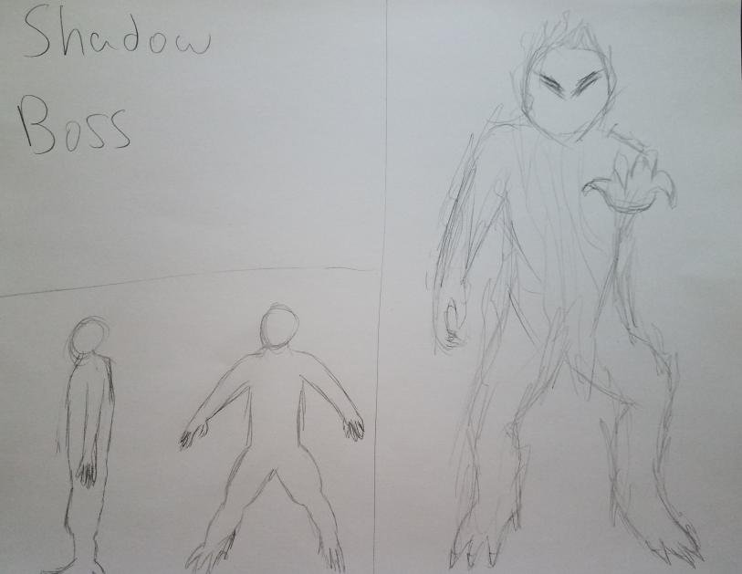
Enemy Design – Normal and Boss
Goblin
Shadow Boss

Slide 16
User Interface and Controls
User Interface:
There will be a “clock” on the top right and a health bar on the top left.
Potentially a stamina bar beneath the heath bar
Icon showing item currently equipped
Inventory menu on pause screen. Select the icon of the item to equip.
Controls:
Wasd movement. Potentially keyboard movement
Space for jump
Left click and right click for sword swing 1 and 2 at minimum
Interact button “E”
Use item button “F”
Roll button shift
Pause button Esc

Slide 17
Target Audience
This game aims to target an older crowd. “Before Dark” can be unsettling since it is an exploration game with a time constraint. This constraint is rather stressful since not only does it serve as a lose condition, but also it serves to strengthen the enemies.
Players should be able to pick up on environmental clues, manage their time well, slay their enemies efficiently, and make it home with time to spare.

Slide 18
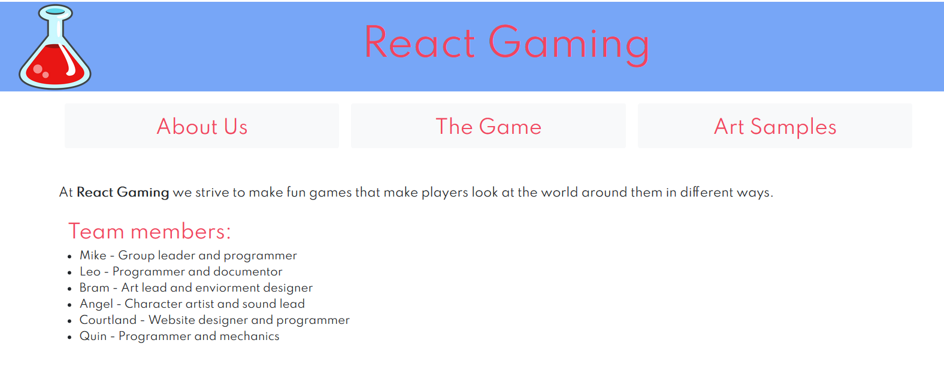
Website

